Slide 1


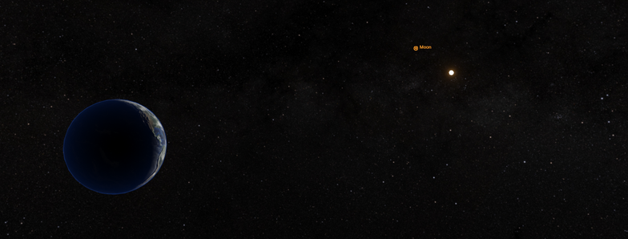
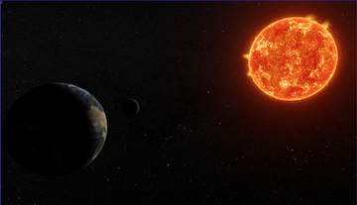

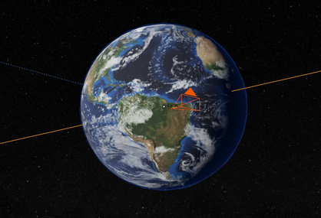
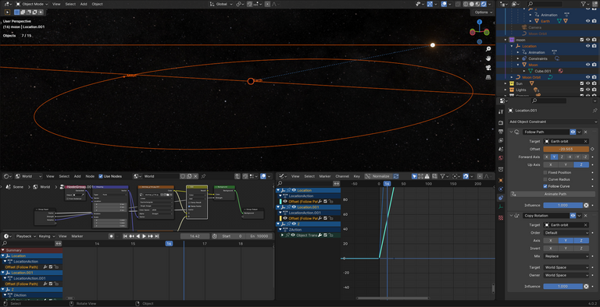
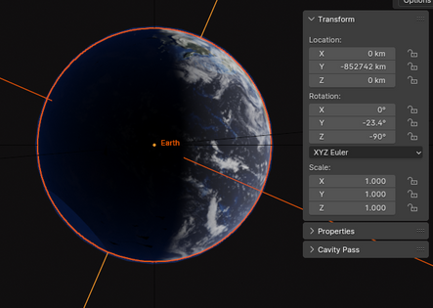
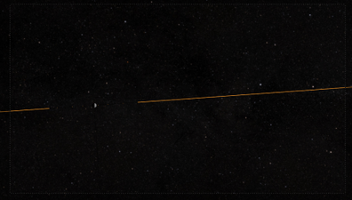
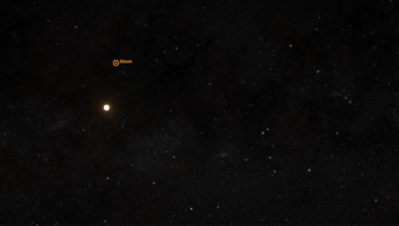

3D Astronomy Simulations for Learning:
Simulating Solar and Lunar Eclipses
Ridwan Haque (rsh28496@uga.edu), Emre Aliya (ealiya2018@gmail.com)
Faculty Mentors: Inseok Song (Song@uga.edu), Nandana Weliweriya (Nandanaw@uga.edu)
Motivation
Earth-Moon-Sun System & Timeline
  Teaching astronomy is challenging due to limitations in technology and outdoor observing sessions.
  We aim to develop 3-D immersive simulations with specific modules to enhance student understanding of astronomical concepts to solve this problem.
  The simulation aims to blend precision and aesthetic appeal in capturing a 3D visualization of a virtual night sky and solar/lunar eclipses.
  We aim to offer these simulations and activities as open-access resources, making them freely available to all students and researchers, irrespective of their institution.
  Utilizing NASA’s resources and measurements, an accurate scaled model of the Earth-Moon-Sun system has been constructed.
  Each number on the Simulation Timeline bar below represents one full earth day.
  The simulation timeline range can be manipulated by the user.
  The user can select any desired time for a lunar viewing session.
Figure 6: Image rendered in EEVEE Render Engine in Blender version 4.0.2 of accurate scaled Earth-Moon-Sun System.
Project Development Roadmap
Figure 2 : Timeline bar in Blender version 4.0.2
PHASE I: Utilize NASA’s VTAD and Statistics to build a precise 3D model of the Earth-Moon-Sun system
PHASE II: Integrate a timeline control for celestial positioning and a viewing camera into the space simulation
PHASE III: Integrate a geolocation feature allowing users to select their viewing location on Earth using latitude and longitude coordinates
PHASE IV: Develop a Python-based GUI for celestial body manipulation with multi-user support
PHASE V: Simulate the Earth’s elliptic orbit and engineer the simulation to be accurate with real life
Geo-Positioned Lunar Observation
  The camera function allows researchers the ability to view the night sky at a certain time and location on Earth.
  The Earth model includes an interactive camera element which is a viewing camera that co-moves with Earth.
  The feature allows users to virtually position a camera anywhere across the globe’s terrain.
  This provides users with a unique perspective to observe and track the moon’s phases and positions.
Current Limitations
  Weather conditions, light pollution, and physical obstructions can disrupt outdoor observing sessions.
  Current astronomy courses are limited to the viewing conditions on campus, which restricts the range of observing conditions that can be demonstrated.
Figure 3: NASA VTAD Earth Model inside Blender. Model follows an elliptical orbit around the Sun
Figure 4: Virtual night sky perspective generated from the camera position in figure 3. First quarter phase of the moon is visualized.
Figure 5: Virtual night sky depicts NASA’s 2020 Deep Star Map utilized from NASA Scientific Visualization Studio.
Figure 7: Screenshot of user interface from Blender 4.0.2. The viewport contains the current status of the Earth-Moon-Sun System simulation.
Figure 1: Replicating realism of Earth’s atmosphere, tilt, and shadows
Visit our Project Website: Stemin3D.net
References: NASA Data https://www.nasa.gov/wp-content/uploads/2015/01/yoss_act1.pdf , https://www.jpl.nasa.gov/edu/pdfs/scaless_reference.pdf , https://www.jpl.nasa.gov/edu/learn/video/solar-system-size-and-distance/ , NASA Scientific Visualization Studio https://svs.gsfc.nasa.gov/4851/ , NASA VTAD https://science.nasa.gov/solar-system/resources/

